Slide 1
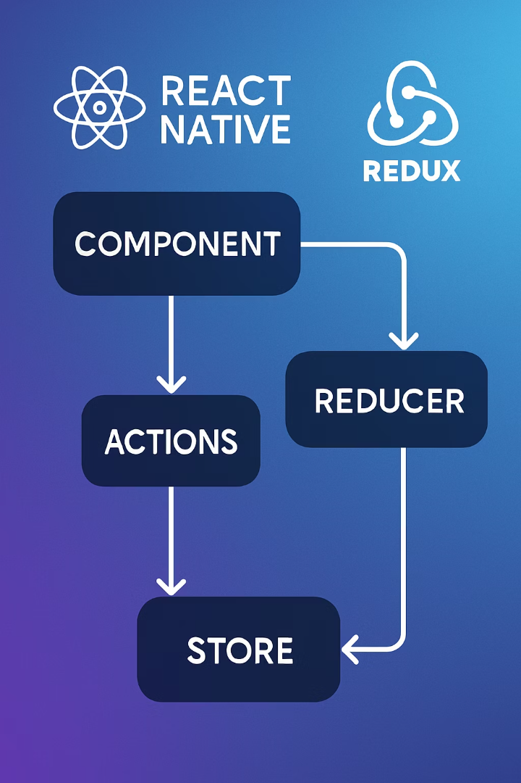

Integrating Redux in React Native
Unlock seamless state management in your React Native app by integrating Redux. This presentation will guide you through Redux concepts and implementation.

Slide 2

Learning Objectives
1
Describe Redux and Redux Toolkit
2
Explain Key Concepts
Understand the core purpose and benefits of Redux for state management.
Learn the fundamental principles and components that make Redux work.
3
Elaborate on Redux Uses
Discover practical applications and advantages of Redux in development.

Slide 3

What is Redux?
State Management Library
Predictable Approach
Makes state changes consistent and traceable throughout your application.
Popular solution for managing application state, especially in React-based apps.
Complex App Solution
Simplifies development and maintenance of applications with complex state needs.

Slide 4



Key Concept 1: Single Source of Truth
Redux stores your entire application state in one centralized object, making it easier to track and manage changes.
The Redux Store
Centralized Management
Unified Structure
A single JavaScript object that holds your entire application state.
All state changes flow through one location, eliminating scattered state logic.
Organized state hierarchy makes debugging and testing significantly easier.

Slide 5

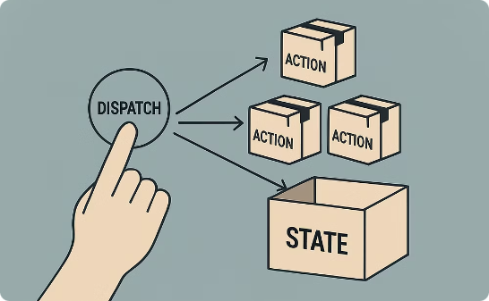
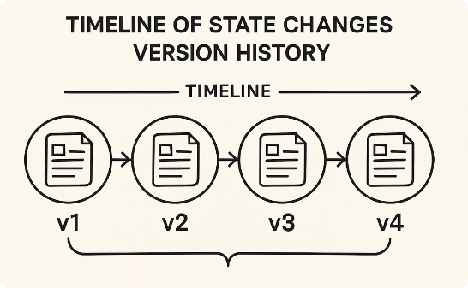
Key Concept 2: State is Read-Only
Immutable State
Dispatch Actions
Traceable Changes
State objects cannot be modified directly - treat the Redux store as a read-only snapshot at any point in time, preventing accidental mutations that lead to hard-to-trace bugs.
Actions (plain JavaScript objects with a type property) are the only way to trigger state changes. They must be dispatched using store.dispatch() and describe what happened in your application.
Each action creates a new state object through reducers, enabling time-travel debugging, state persistence, and undo/redo functionality - making your React Native app more predictable and easier to debug.

Slide 6
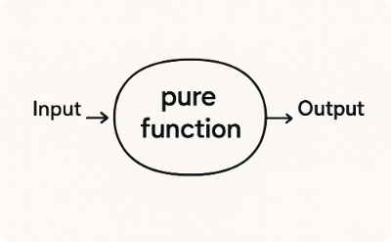

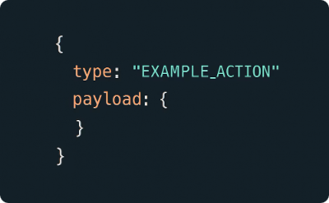
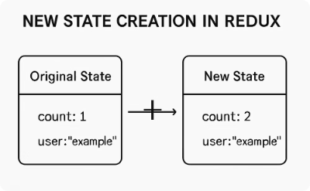
Key Concept 3: Pure Functions
Reducers
Current State
Action
New State
Pure functions that take state and action as arguments, producing predictable outputs without side effects or mutations
The existing state object passed to the reducer—never modified directly to maintain immutability principles
Plain JavaScript object with a 'type' property and optional payload that describes what change should occur
An entirely new state object created by reducer logic, enabling time-travel debugging and predictable state changes

Slide 7

Evolution to Redux Toolkit
1
Traditional Redux
Original approach with more boilerplate code.
2
Developer Challenges
Complex setup and verbose implementation.
3
Redux Toolkit Introduction
Official package to simplify Redux development.
4
Current Standard
Now the recommended approach for Redux logic.

Slide 8

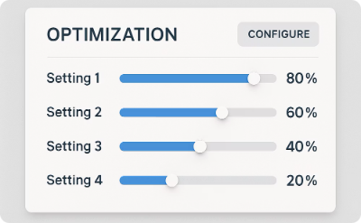
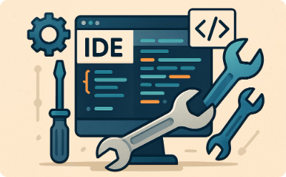
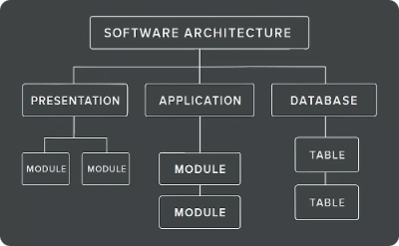
Benefits of Redux Toolkit
Less Boilerplate
Better Defaults
Integrated Tools
Maintainable Code
Reduces repetitive code patterns, allowing you to focus on what matters.
Pre-configured with recommended settings to get you started quickly.
Includes createSlice and configureStore utilities for streamlined development.
Results in cleaner, more scalable applications that are easier to maintain.

Slide 9




Components of Redux
Redux architecture consists of four main parts working together to create a predictable state container.
UI Components
React Native components that connect to Redux via hooks like useSelector and useDispatch to read state and trigger actions
Actions & Dispatch
Plain JavaScript objects with a type property that describe what happened, created efficiently with Redux Toolkit's createSlice API
Reducers
Pure functions that handle state transitions based on actions, automatically generated by Redux Toolkit to prevent mutations
Store
Single source of truth that holds the entire application state, configured with configureStore to include middleware and DevTools
These components work together in a unidirectional data flow pattern, making state changes predictable and traceable throughout your React Native application.

Slide 10



Creating a Redux Slice
Define Initial State
Establish the starting state object for your feature using Redux Toolkit's createSlice API
Create Reducers
Implement pure functions that handle state transitions without mutations. Redux Toolkit handles immutability automatically
Export Actions
Extract and export the auto-generated action creators that components will use with useDispatch

Slide 11
Counter Slice Example
//counterSlice.js import { createSlice } from '@reduxjs/toolkit' export const counterSlice = createSlice({ name: 'counter', initialState: 0, reducers: { increment: (state) => state + 1, decrement: (state) => state - 1, }, }) export const { increment, decrement } = counterSlice.actions export default counterSlice.reducer

Slide 12



Configuring the Store
Import configureStore
From Redux Toolkit package
Add Reducers
Connect feature reducers to store
Set Up Defaults
Middleware and DevTools configured automatically

Slide 13
Store Configuration Example
//store.js import { configureStore } from '@reduxjs/toolkit' import counterReducer from './counterSlice' export const store = configureStore({ reducer: { counter: counterReducer, }, })

Slide 14




Connecting Store to React Native
Import Provider
Wrap Root Component
Pass Store
From react-redux package to connect store with components.
Place Provider around your app's main component.
Supply the configured store as a prop to Provider.

Slide 15

Provider Implementation
//app.js import React from 'react' import { Provider } from 'react-redux' import { store } from './store' import Counter from './Counter' export default function App() { return ( <Provider store={store}> <Counter/> </Provider> ) }

Slide 16
Complete Counter Component
import React from 'react'
import { View, Text, Button } from 'react-native'
import { useSelector, useDispatch } from 'react-redux'
import { increment, decrement } from './counterSlice'
export default function Counter() {
const count = useSelector(state => state.counter)
const dispatch = useDispatch()
return (
<View style={styles.container}>
<Text style={styles.countText}>Count: {count}</Text>
<View style={styles.buttonContainer}>
<Button title="Increment" onPress={() => dispatch(increment())} />
<Button title="Decrement" onPress={() => dispatch(decrement())} />
</View>
</View>
)
}
const styles = StyleSheet.create({
container: {
flex: 1,
justifyContent: 'center',
alignItems: 'center',
},
countText: {
fontSize: 24,
marginBottom: 20,
},
buttonContainer: {
flexDirection: 'row',
justifyContent: 'space-between',
width: 200,
},
})

Slide 17
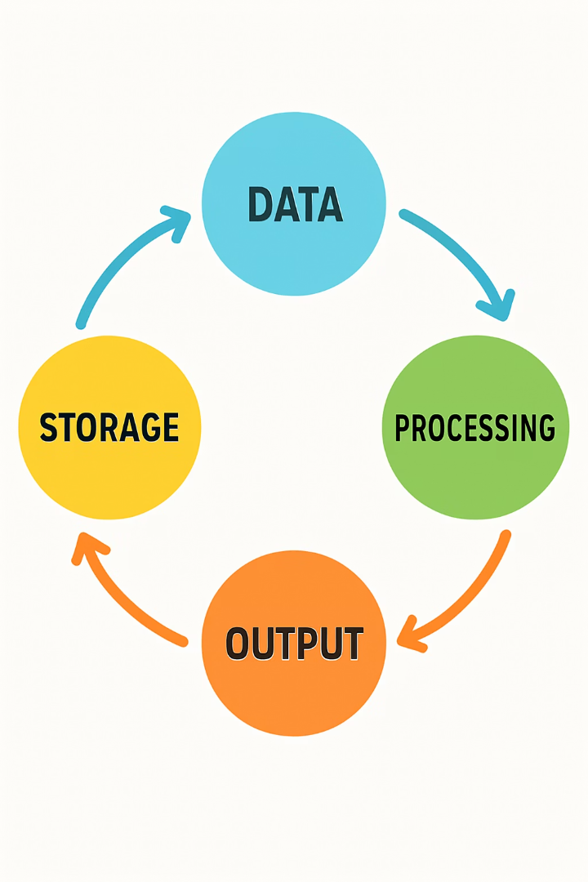




Redux Flow Overview
Define State & Reducers
Create slice with initial state and update logic.
Configure Store
Set up Redux store with reducers.
Provide Store
Make store available to component tree.
Interact with Store
Components read state and dispatch actions.

Slide 18

User Interaction Flow
User Action
1
User presses increment button
Dispatch
2
Component dispatches increment action
Reducer
3
Reducer creates new state (count + 1)
UI Update
4
Component re-renders with new count

Slide 19
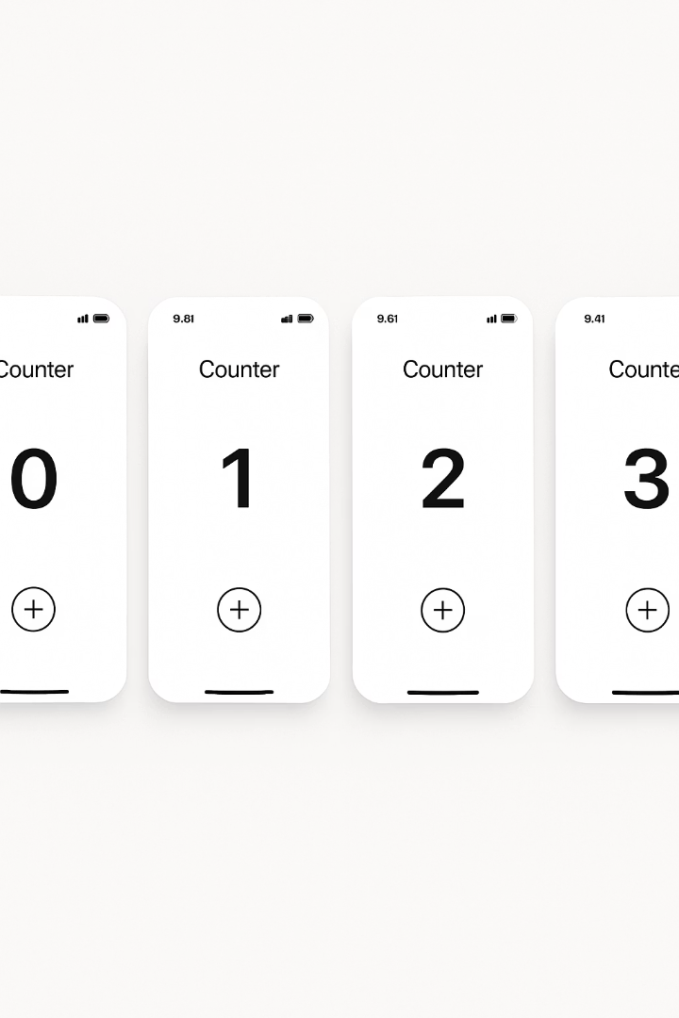
Counter App Output
0
Initial State
App starts with counter at zero.
1
After Increment
Counter increases by one.
2
Another Increment
Counter increases again.
-1
After Decrement
Counter can go negative.

Slide 20
Predictable State Management
Centralized Updates
Unidirectional Data Flow
All state changes follow the same pattern through reducers.
Data always flows in one direction: view → action → reducer → store → view.
No more hunting through components to find where state changes.
Makes application behavior more predictable and easier to reason about.

Slide 21
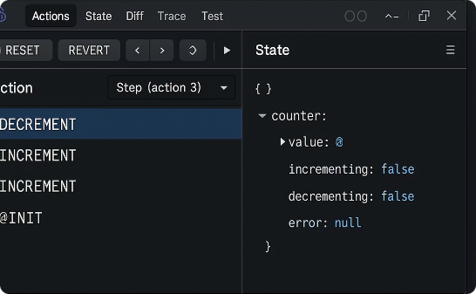
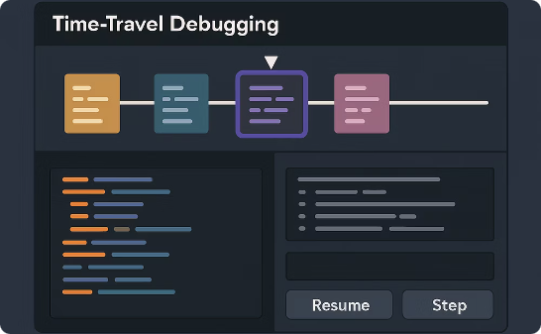
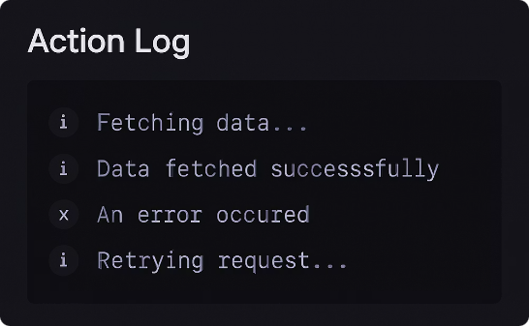
Ease of Debugging
Redux DevTools
Time Travel Debugging
Action Logging
Track every state change in your application with specialized tools.
Jump between different states to identify when issues occur.
See exactly which actions were dispatched and in what order.

Slide 22

Maintainability Benefits
Separation of Concerns
Testability
UI components focus on presentation. Redux handles state logic.
Pure functions are easy to test. State logic can be verified independently.
Scalability
Consistency
Pattern works for small apps and large enterprise applications.
Standardized approach to state management across the application.

Slide 23





Redux Ecosystem
Redux has a rich ecosystem of middleware, tools, and plugins that extend its functionality for specific needs.

Slide 24

When to Use Redux
Complex State
Shared State
Time Travel
Large Teams
When your application has numerous interconnected state pieces that affect multiple UI components across different screens or navigation paths.
When data needs to be accessed by unrelated components at different levels of the component tree without excessive prop drilling.
When debugging requires tracking every state change, like in applications where you need to reproduce and investigate specific user-reported issues.
When multiple developers need to work on state management with a standardized, predictable pattern that enforces separation of concerns.

Slide 25





When Not to Use Redux
Simple React Native Apps
Learning React Native Fundamentals
Single-screen applications with minimal state changes don't justify Redux's boilerplate. Context API or useState will be more efficient for basic forms or simple navigation states.
New developers should master component lifecycle, hooks, and navigation patterns before introducing Redux's complexity. Adding Redux too early can overwhelm the learning process.
Animation-Heavy Applications
Rapid Prototyping Phases
Apps with complex animations and many rapid UI updates may experience performance bottlenecks with Redux. Consider React's useReducer or specialized animation state libraries instead.
When building MVPs with tight deadlines, Redux's setup cost (creating actions, reducers, and store configuration) can slow development velocity without immediate benefits.

Slide 26

Redux Alternatives
Context API
Built into React, simpler but less powerful than Redux
MobX
Uses observable patterns, less boilerplate than Redux
Recoil
Facebook's experimental state management library
Zustand
Minimalist approach with hooks-based API
Jotai
Atomic approach to state management

Slide 27
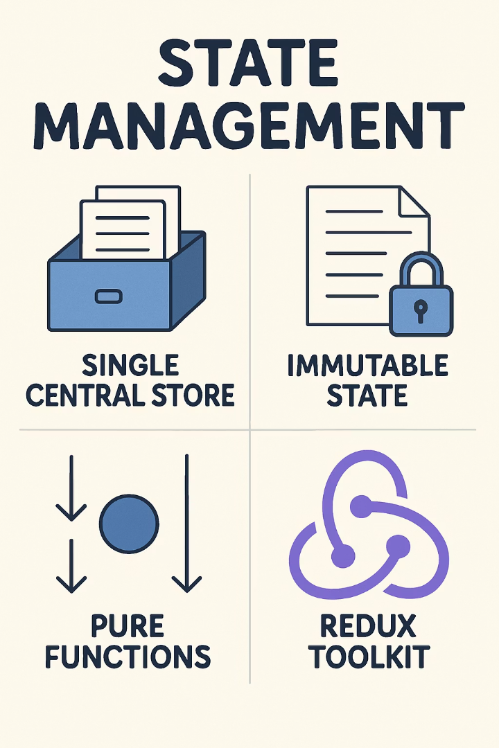




Key Takeaways
Single Store
All state in one central location.
Immutable State
State is read-only, changed via actions.
Pure Functions
Reducers create new state predictably.
Redux Toolkit
Modern approach with less boilerplate.

